Slide 1
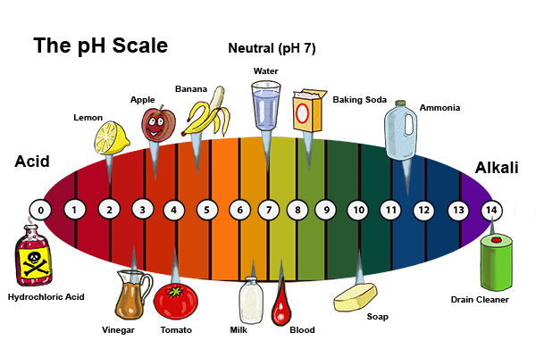
ACIDS AND BASES

Slide 2
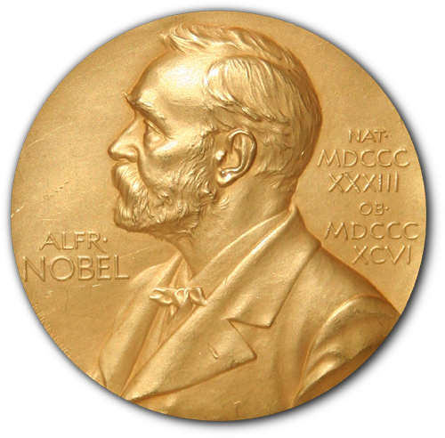
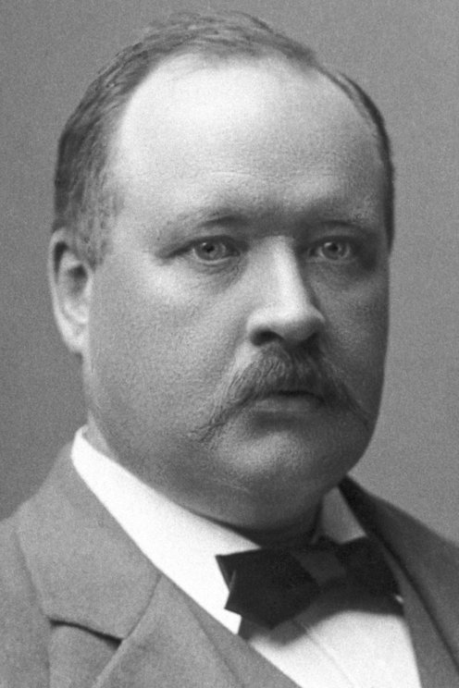
Svante Arrhenius (1859-1927)
Swedish scientist
The Nobel Prize in Chemistry 1903 was awarded to Svante August Arrhenius "in recognition of the extraordinary services he has rendered to the advancement of chemistry by his electrolytic theory of dissociation."

Slide 3
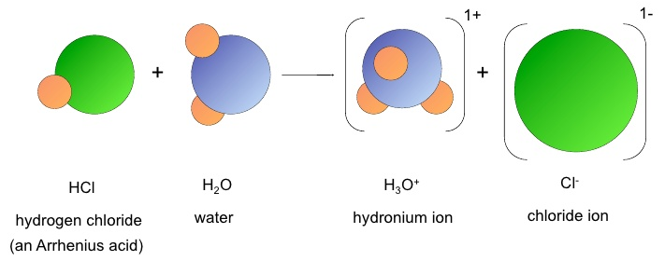
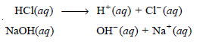
ARRHENIUS concept of acids and bases
Savante Arrhenius (1884) proposed his concept of acids and bases. According to this concept, an acid is a compound that releases H+ ions in water; and a base is a compound that releases OH– ions in water. For example, HCl is an Arrhenius acid and NaOH is an Arrhenius base.
Limitations of Arrhenius concept
It is only applicable in aqueous solutions. Arrhenius defined acids and bases as compounds producing H+ and OH– ions in water only. But a truly general concept of acids and bases should be appropriate to other solvents as well.
Some bases do not contain OH– Arrhenius base is one that produces OH– ions in water. Yet there are compounds like ammonia (NH3) and calcium oxide (CaO) that are bases but contain no OH– ions in their original formulation.

Slide 4
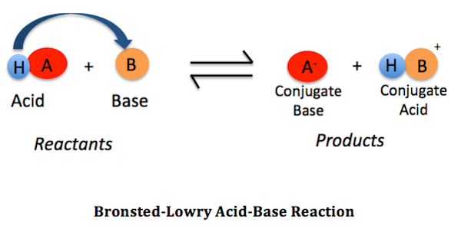
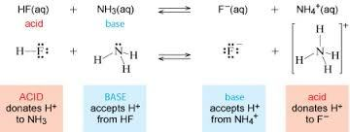
BRONSTED–LOWRY CONCEPT
In 1923 J.N. Bronsted and J.M. Lowry independently proposed a broader concept of acids and bases. According to this theory,
an acid is any molecule or ion that can donate a proton (H+)
a base is any molecule or ion that can accept a proton
For brevity we can say that an acid is a proton donor while a base is a proton acceptor.

Slide 5
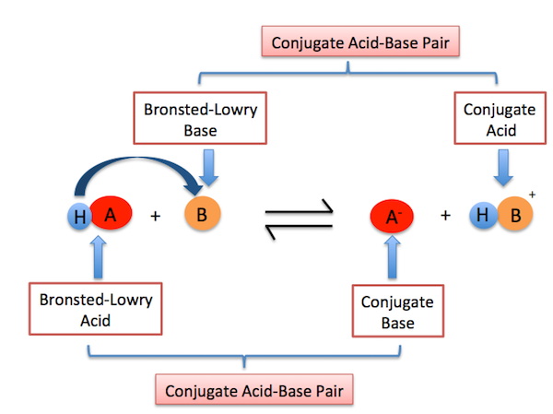

Slide 6
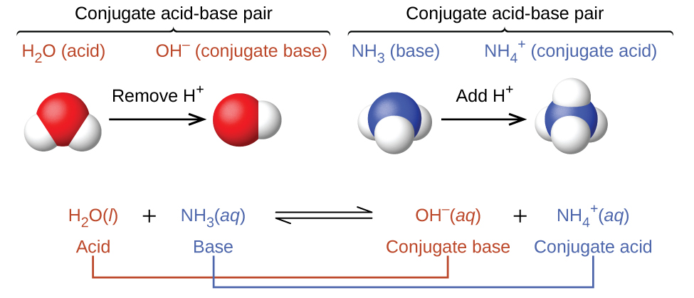

Slide 7
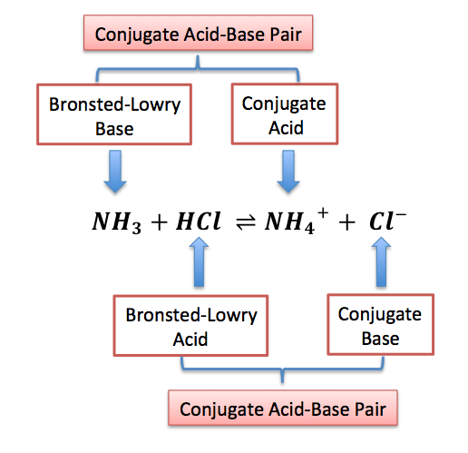
Bronsted-Lowry concept is superior to Arrhenius concept
(1) Much wider scope. Arrhenius concept of acids and bases is restricted to the study of substances which can release H+ or OH– ions in water. Bronsted-Lowry concept embraces all molecules and ions that can donate a proton (acids) and those which can accept a proton (bases).
(2) Not limited to aqueous solutions. The Bronsted-Lowry model is not limited to aqueous solutions as is the case with Arrhenius model. It can be extended even to the gas phase. For example, gaseous ammonia (a Bronsted base) can react with hydrogen chloride gas (a Bronsted acid) to give ammonium chloride.

Slide 8
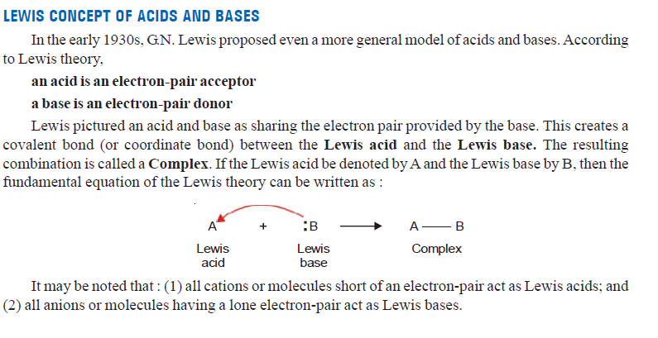
Lewis concept of acids and bases

Slide 9
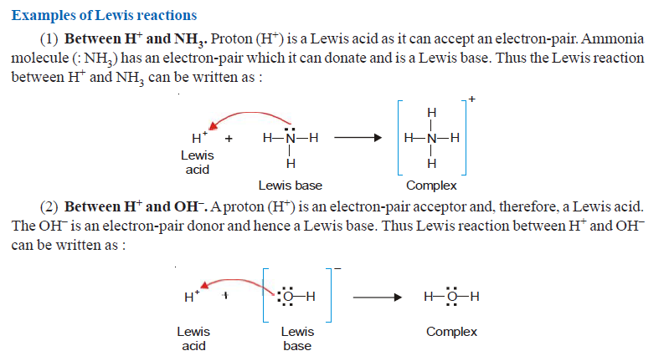

Slide 10
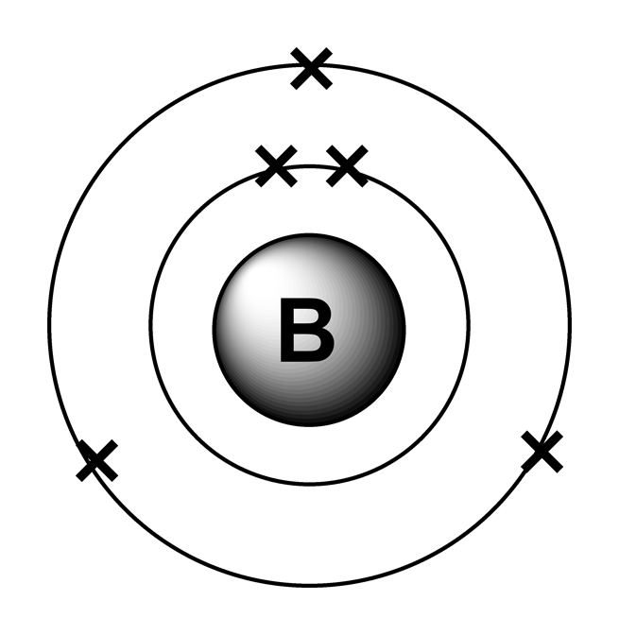
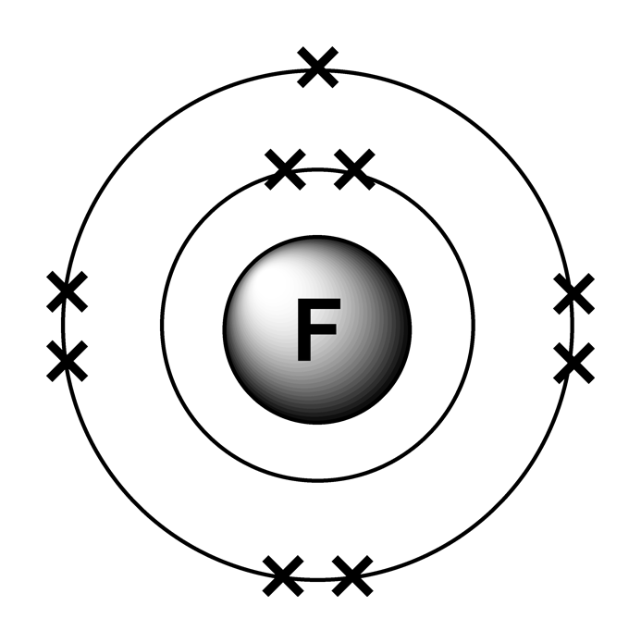
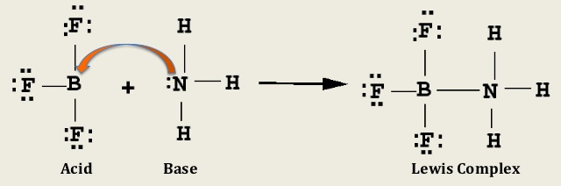
Superiority of Lewis model of acids and bases
The advantages of the Lewis acid-base model are :
All the Bronsted-Lowry acid base reactions are covered by the Lewis model. It is so because the transfer or gain of a proton is accompanied by the loss or donation of an electron-pair in both types of reactions.
(2) Many reactions which do not involve transfer of a proton are also covered by the Lewis theory. e.g.,
BF3 + NH3 ⎯⎯→ BF3 — NH3

Slide 11
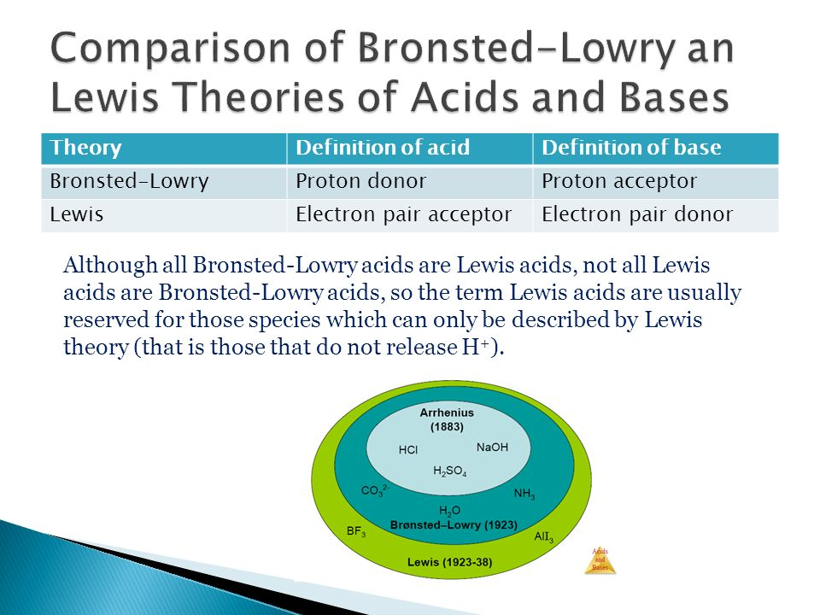
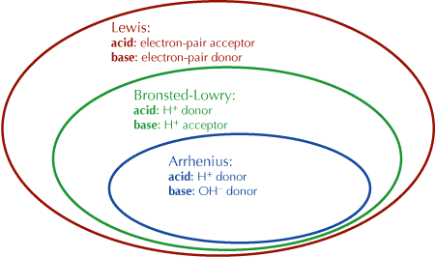

Slide 12
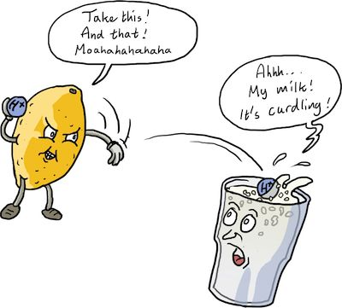

Slide 13
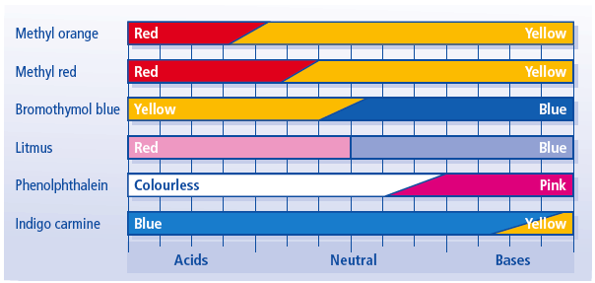
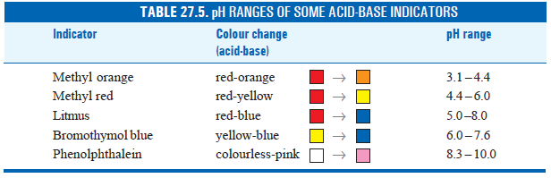
Acid–base indicators
When the amount of the base added equals the amount of the acid in the flask, the equivalence point or the end-point is reached.
The end-point of a titration is shown by colour change of an indicator previously added to the acid solution in the receiver flask.
An acid-base indicator is an organic dye that signals the end-point by a visual change in colour.
Phenolphthalein and methyl orange are two common examples of acid-base indicators.
Phenolphthalein is pink in base solution and colourless in acid solution.
When added to the acid solution in the receiver flask, it shows no colour. As the added base is in slight excess, it becomes pink. Thus phenolphthalein signals the end-point by a colour change from colourless to pink.
Similarly methyl orange indicates the end-point by a colour change from red (in acid) to yellow (in base).

Slide 14
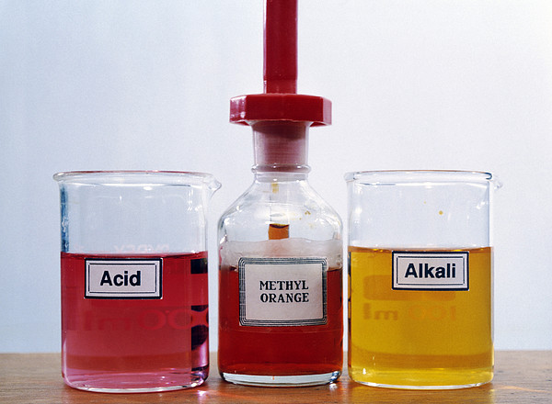
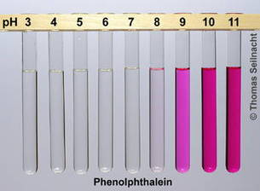
METHYL ORANGE
PHENOLPHTHALEIN

Slide 15
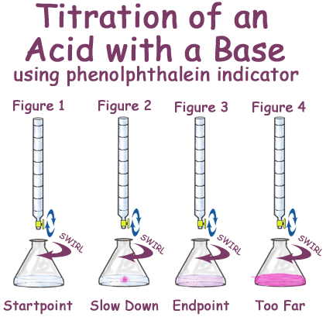
Titration
Titration is the slow addition of one solution of a known concentration (called a titrant) to a known volume of another solution of unknown concentration until the reaction reaches neutralization, which is often indicated by a color change. In titration the known concentration is used to determine the concentration of an unknown solution.
Choice of a suitable indicator
The choice of a suitable indicator for a particular acid-base titration depends on the nature of the acid and the base involved in the titration. We may have the titration of :
(a) a strong acid with a strong base
(b) a weak acid with a strong base
(c) a strong acid with a weak base
(d) a weak acid with weak base
Which indicator is suitable for a given titration, can be found by examining the titration curve of that titration.

Slide 16
Theories of acid-base indicators
Two theories have been put forward to explain the indicator action in acid-base titrations :
(1) The Ostwald’s theory
(2) The Quinonoid theory
The Ostwald’s theory
According to this theory :
an acid-base indicator is a weak organic acid (HIn) or a weak organic base (InOH), where the letter “In” stands for a complex orange group. Methyl orange and phenolphthalein are both weak acids.
the un-ionised indicator, HIn, has a colour different from the In– ions produced by the ionization of the indicator in aqueous solution.
the degree of ionisation of the indicator determines the visible colour of the indicator solution.

Slide 17
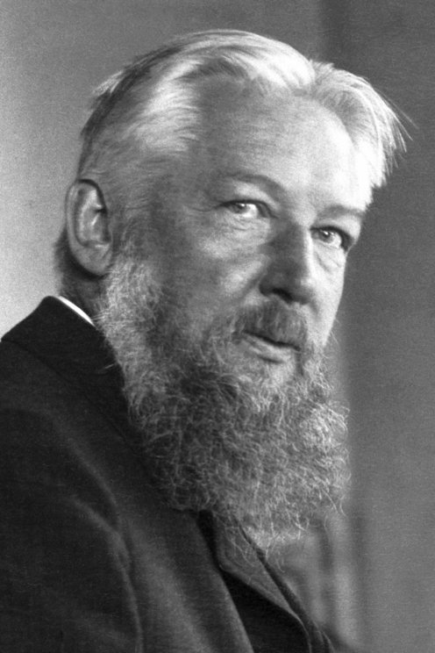
Wilhelm Ostwald 1853-1932
The Nobel Prize in Chemistry 1909 was awarded to Wilhelm Ostwald "in recognition of his work on catalysis and for his investigations into the fundamental principles governing chemical equilibria and rates of reaction."

Slide 18
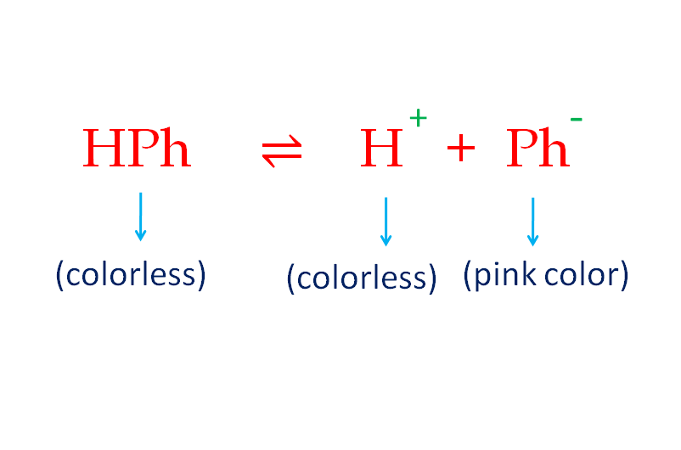
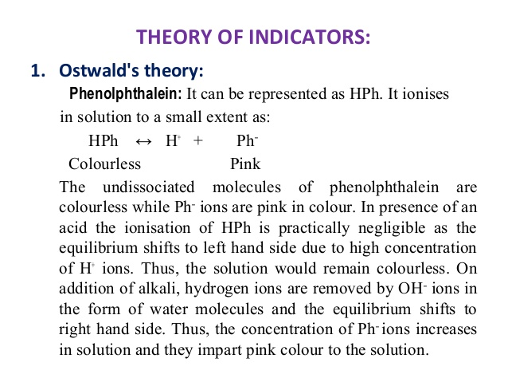
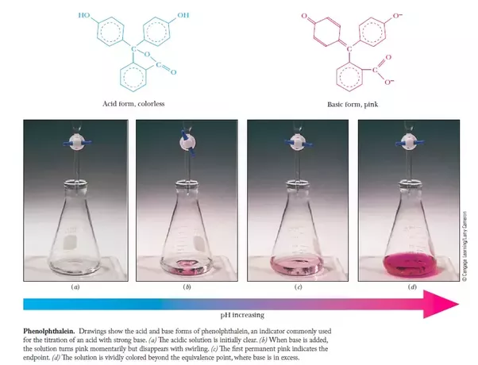

Slide 19
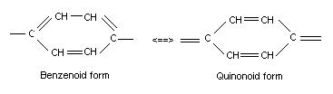
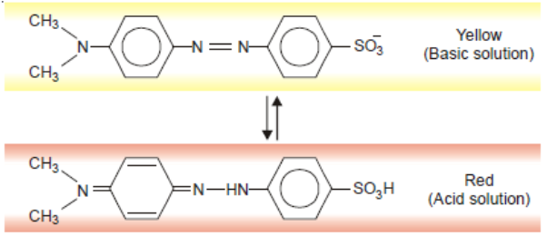
Quinonoid theory
The acid-base indicators exist in two tautomeric forms having different structures. Two forms are in equilibrium. One form is termed benzenoid form (light colour) and the other quinonoid form (deep colour).
The two forms have different colors. The color change in due to the interconversation of one tautomeric form into other.
One form mainly exists in acidic medium and the other in alkaline medium.

Slide 20
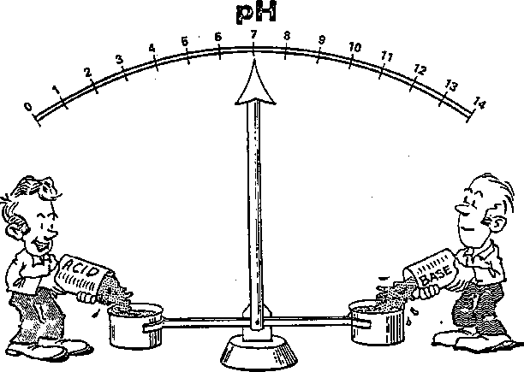

RELATIVE STRENGTH OF ACIDS AND BASES

Slide 21
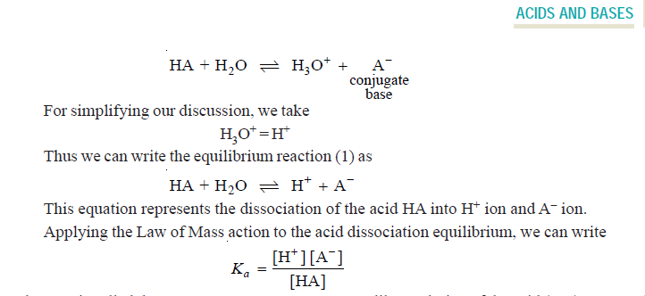
Relative strength of acids
The strength of an acid is defined as the concentration of H+ ions in its aqueous solution at a given temperature.
The strength of an acid depends on its ability to transfer its proton (H+) to a base to form its conjugate base. When a monoprotic acid (HA) dissolves in water, it transfers its proton to water (a Bronsted base) to form hydronium ion (H3O+) and a conjugate base.

Slide 22
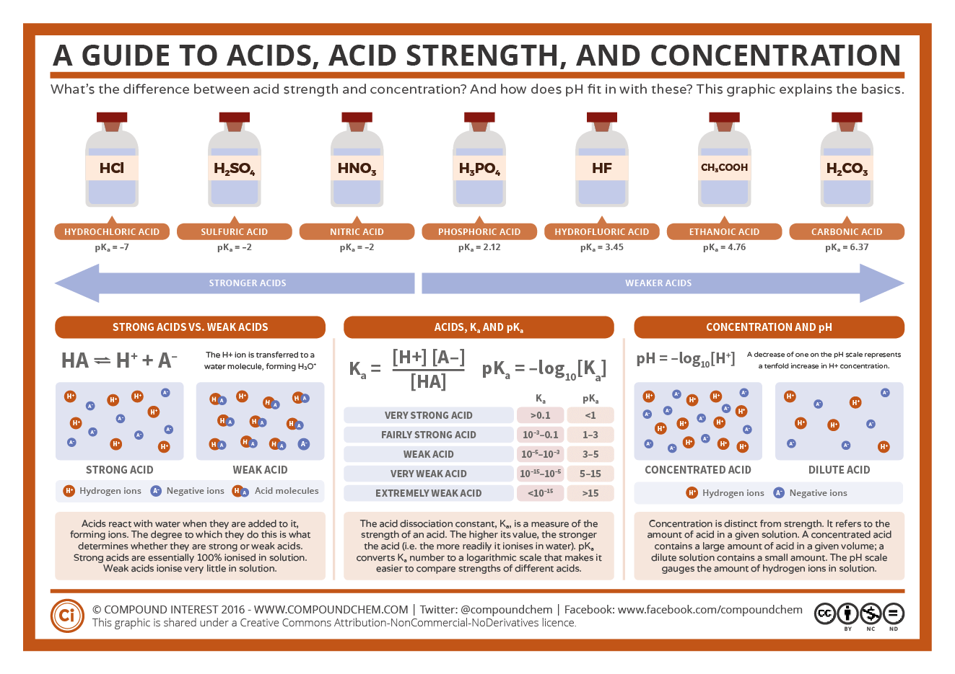

Slide 23
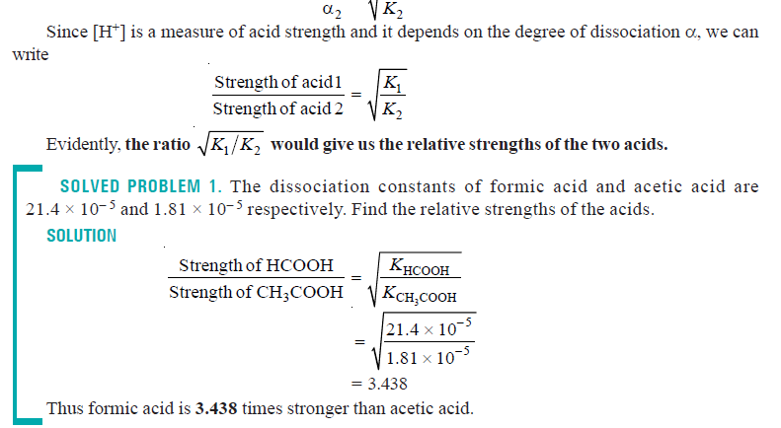
Calculation of Relative strength of Weak acids from Ka

Slide 24


Slide 25
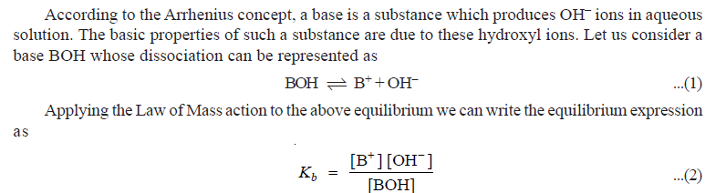
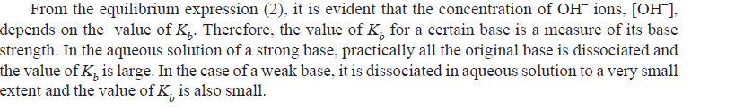
Relative strength of bases
The strength of a base is defined as the concentration of OH– ions in its aqueous solution at a given temperature.

Slide 26
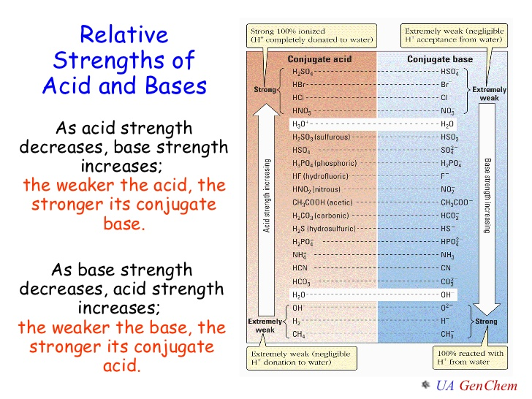

Slide 27
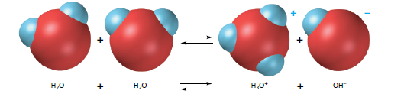
Self-Ionization of Water
Although pure water is often considered a nonelectrolyte (nonconductor of electricity), precise measurements do show a very small conduction. This conduction results from self-ionization (or autoionization), a reaction in which two like molecules react to give ions.
In the case of water, a proton from one H2O molecule is transferred to another H2O molecule, leaving behind an OH ion and forming a hydronium ion, H3O(aq).

Slide 28
pH scale
The pH scale, (0 - 14), is the full set of pH numbers which indicate the concentration of H⁺ and OH⁻ions in water.
pH Scale Principle
H⁺ ion concentration and pH relate inversely
OH⁻ ion concentration and pH relate directly.
a. Increasing pH means the H⁺ ions are decreasing. b. Decreasing pH means H⁺ ions are increasing. c. Increasing pH means OH⁻ ions are………………...? d. Decreasing pH means OH⁻ ions are……………….?

Slide 29
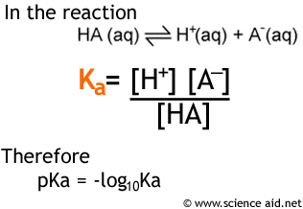
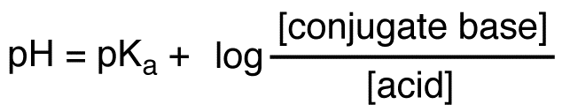
pKa
The pKa expresses, on a logarithmic scale, the relative strength of a weak acid or base
Henderson–Hasselbalch equation
This equation shows how the pH could be estimated using the pKa. pKa is a measure of acid strength. It depends on the identity and chemical properties of the acid. pH is a measure of [H+] in a solution. For acids, the smaller the pKa, the more acidic the substance is (the more easily a proton is lost, thus the lower the pH).
The stronger the acid, the lower its pKa; the stronger the base, the higher its pKa. The pKa can be determined experimentally; it is the pH at the midpoint of the titration curve for the acid or base.

Slide 30
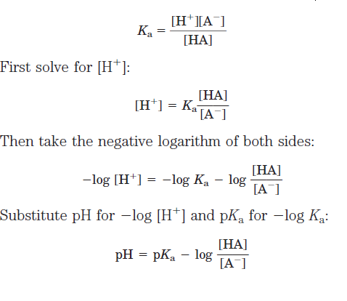
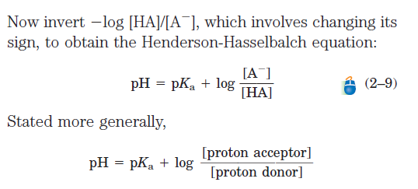
pH and pKa relationship
Henderson-Hasselbalch equation can be used to determine the relationship between buffer pH and pKa.
Hasselbalch equation, which is important for understanding buffer action and acid-base balance in the blood and tissues of vertebrates. This equation is simply a useful way of restating the expression for the dissociation constant of an acid. For the dissociation of a weak acid HA into H and A, the Henderson- Hasselbalch equation can be derived as follows:
An equivalence point is when the moles of a standard solution (titrant) equal the moles of a solution of unknown concentration (analyte).
At half the equivalence point: pH = pKa

Slide 31
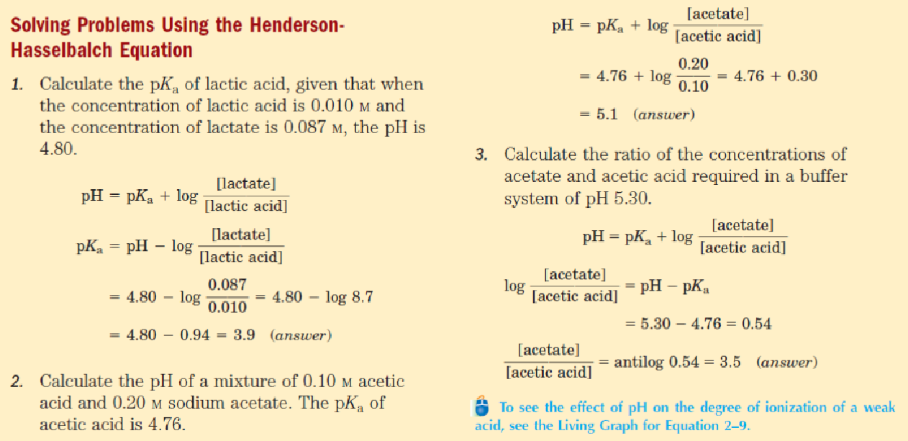

Slide 32
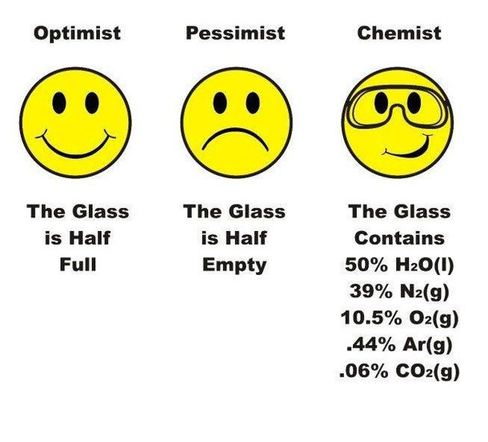
M H M Mubassir
MNS, BRACU

Slide 33

Assignment
Importance of Chemistry in life!

Slide 35

Buffer solution
A buffer solution is one which maintains its pH fairly constant even upon the addition of small amounts of acid or base.
We can add a small amount of an acid or base to a buffer solution and the pH will change very little.
a weak acid together with a salt of the same acid with a strong base. These are called Acid buffers e.g., CH3COOH + CH3COONa.
a weak base and its salt with a strong acid. These are called Basic buffers. e.g., NH4OH + NH4Cl.
Acid Buffer= Weak acid + Its salt
Base Buffer= Weak Base + Its salt

Slide 36

Buffer Capacity
Buffering capacity is the number of grams of strong acid or alkali which is necessary for а change in pH of one unit of one liter of buffer solution.
On the other hand, the ability of the buffer to resist changes in pH when an acid or base is added.

Slide 37
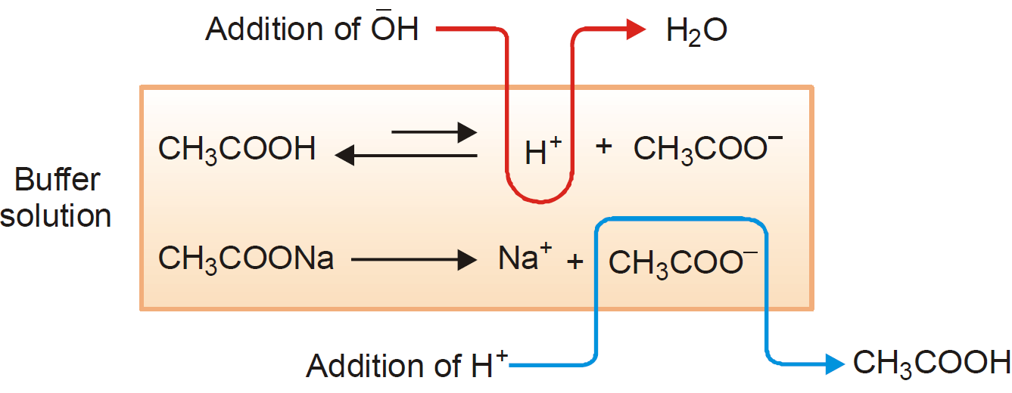
How a buffer operates?
For acid buffer
Addition of H+
H+ | OH- | Mechanism
1 | 0 | Normal State
2 | 0 | Addition of H+ (transition state)
1 | 0 | Formation of CH3COOH

Slide 38
Addition of OH-
H+ | OH- | Mechanism
1 | 0 | Normal State
1 | 1 | Addition of OH- (transition state)
0 | 0 | Formation of H2O (transition state)
1 | 0 | Formation of H+ & CH3COO- from old CH3COOH

Slide 39
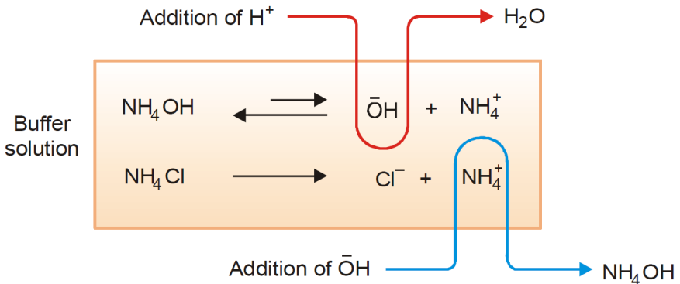
How a buffer operates?
For base buffer
1. Addition of H+
2. Addition of OH-

Slide 40
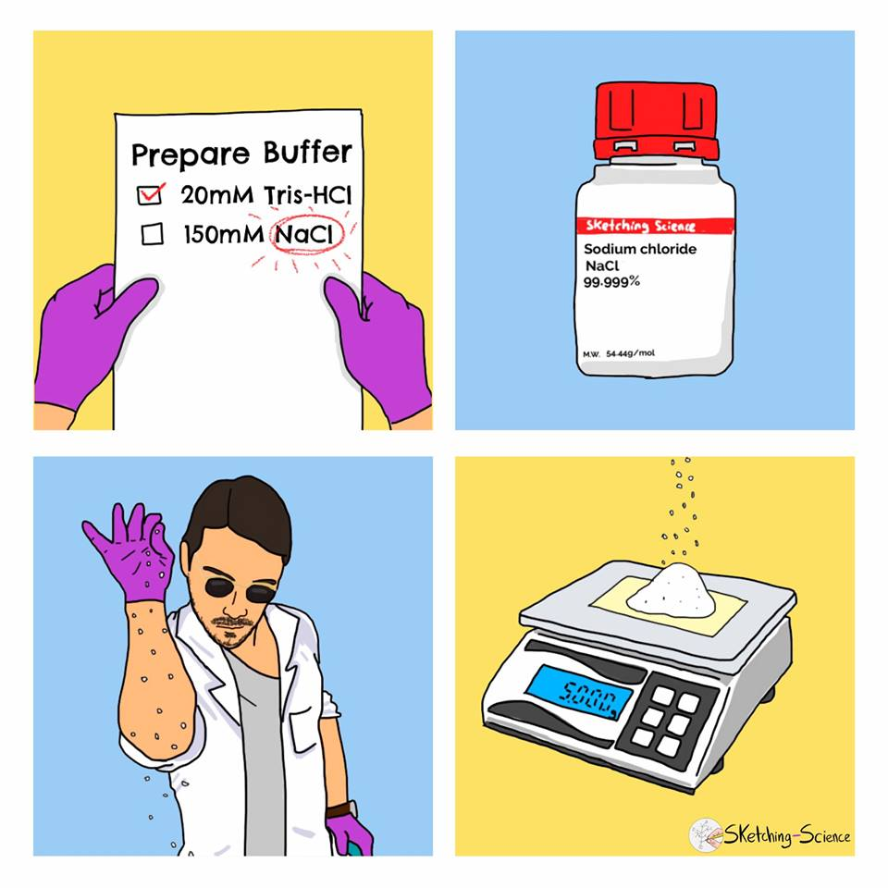
Thank You!

